Slide 1

Interactive Socio-Technical Practicum (DP-301P)
Introduction to Research
Dr. Rajeshwari Dutt, SHSS
Acknowledgments:
Dr. Parmod Kumar
Dr. Devika Sethi

Slide 2






























Science

Slide 3

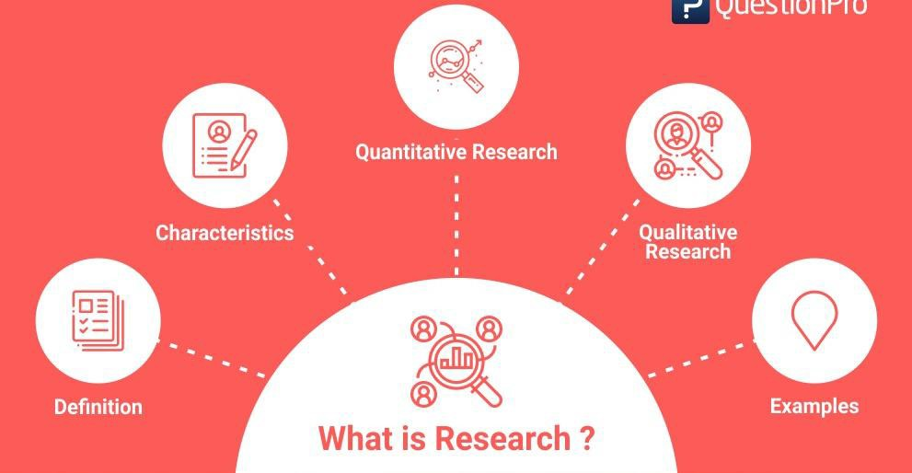
Research
“Research is a systematic inquiry to describe, explain, predict and control the observed phenomenon. Research involves inductive and deductive methods.”

Slide 4
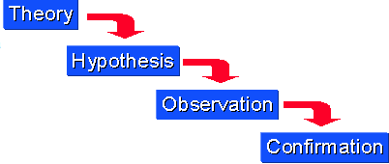
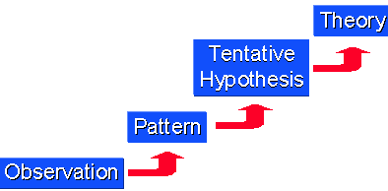
Deductive Method
Deductive InI
Inductive Method
Notes:
Science students/engineers are very uncomfortable with this model. The problem is, there is too much uncertainty. Initially, they look to the advisors for direction and lack confidence. Very time consuming!

Slide 5
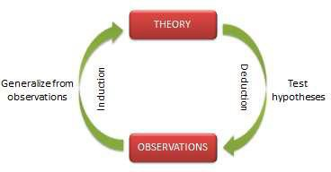
Scientific research
Operates at two levels: a theoretical level and an empirical level.
Theoretical research: concerned with developing abstract concepts about a natural or social phenomenon and relationships between those concepts.
Empirical research: concerned with testing the theoretical concepts and relationships to see how well they reflect our observations of reality, with the goal of ultimately building better theories.

Slide 6
Scientific methods
Standardized set of techniques for building scientific knowledge, such as how to make valid
observations, how to interpret results, and how to generalize those results.
Logical: Scientific inferences must be based on logical principles of reasoning.
Confirmable: Inferences derived must match with observed evidence.
Repeatable: Other scientists should be able to independently replicate or repeat a scientific study and obtain similar, if not identical, results.
Scrutinizable: The procedures used and the inferences derived must withstand critical scrutiny (peer review) by other scientists.

Slide 7
Types of scientific research
Exploratory research: often conducted in new areas of inquiry, where the goals of the research are: (1) to scope out the magnitude or extent of a particular phenomenon, problem, or behavior, (2) to generate some initial ideas about that phenomenon, or (3) to test the feasibility of undertaking a more extensive study regarding that phenomenon.
Descriptive research: directed at making careful observations and detailed documentation of a phenomenon of interest; examines the what, where, and when of a phenomenon.
Explanatory research: seeks explanations of observed phenomena, problems, or behaviors; seeks answers to why and how types of questions and attempts to “connect the dots” in research, by identifying causal factors and outcomes of the target phenomenon.

Slide 8

Major Approaches to Social Science Research
Positivist Methodology
Emphasis on observable facts
Human behaviour is explained by laws
The social world can be studied in a ‘scientific’ way
Standardization and Objectivity
Emphasis on Quantitative method
Interpretivist Methodology
There is a distinction between natural science and social science
Human behaviour can only be understood if we understand motivation and intention
Not just explain in terms of cause and effect, but UNDERSTAND from the point of view of the people we are studying
Emphasis on Qualitative Method

Slide 9

A New Approach to Social Science Research
Critical Social Research
To know the social world, take in to account the social, political and historical context
Focus on deprived groups
Has an emancipatory agenda
The purpose of research is not just to generate knowledge, but to CHANGE society

Slide 10











Stages for conducting research
Selection of broad area/topic
Literature Review
Development of theoretical and conceptual frameworks
Clarification of research questions\hypothesis
Research design
Data collection
Data analysis
Drawing conclusions
Dissemination

Slide 11
Selection of broad area/topic
Take up most, if not all of your time at the beginning is that of selecting a topic, and
developing a preliminary research question and set of objectives.
Selection of your research question is a crucial stage, as an inappropriate topic or question will often lead to irretrievable difficulties later.
It is worth dealing with this stage carefully.
Unlikely that you will develop a final question and set of objectives at this stage of the research process.
The following two stages are important in developing and assessing your question more fully.

Slide 12
Literature review
Consists of critically reading, evaluating and organising existing literature on the topic to assess the state of knowledge in the area.
Aim to become an 'expert' in your field of research.
Generally done alongside the development of the theoretical and conceptual frameworks.
Reading widely may also alert you to other helpful factors, such as whether similar research has already been carried out, show you the types of findings that you could expect, or provide descriptions of the theoretical frameworks and previous methodologies adopted by others doing similar research.

Slide 13
Development of theoretical framework
Continually developing and refining your theoretical and conceptual frameworks.
Can often be overlooked in the haste to collect data.
A vital part of the research process and is important in alerting you to potential problems
before they occur.
Theoretical framework refers to the underlying theoretical approach that you adopt to
underpin your study.
The conceptual framework defines and organises the concepts important within the study.

Slide 14
Clarification of research questions
Stages 1-3 of research process will initially become a circular process, whereby initial research questions are chosen, investigated and often rejected for a number of reasons.
Stages 1-3 can take longer than initially anticipated, and you may well become discouraged by a lack of success in identifying a good research question or hypothesis.
No easy methods to come up with an appropriate question and it can be very much a case of
perseverance.
Once developed a good, focused research question, then the rest of the research process is based upon answering that specific question.
Common fault is the lack of clarity over the overall aim of the research, without this, it is
difficult to maintain your vertical thread.

Slide 15
Research design
Once the focused research question has been ascertained, the next stage is to consider two questions:
What data do I need to collect to answer this question?
What is the best way to collect this data?
Breaking this down into more detail, the issues faced by the researcher are:
What overall research design should I use? Will I, for example, use a crosssectional, experimental or longitudinal design?
Will I need to collect primary data, or will there be suitable secondary data to use?
What methods, for example interviews, questionnaire surveys and so on, will be the best ones to collect the primary data?
Who should participate in the research, and how will I gain access to them?
What are the exact procedures that I should adopt in my data collection to ensure reliability and validity?
Notes:
Longitudinal studies and cross-sectional studies are two different types of research design. In a cross-sectional study you collect data from a population at a specific point in time; in a longitudinal study you repeatedly collect data from the same sample over an extended period of time. Experimental design is the process of carrying out research in an objective and controlled fashion so that precision is maximized and specific conclusions can be drawn regarding a hypothesis statement. Generally, the purpose is to establish the effect that a factor or independent variable has on a dependent variable.

Slide 16
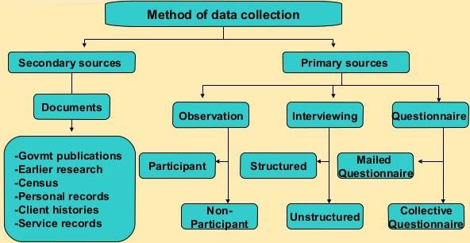
Data collection
One should have a clear idea of what data to collect, and how to collect it.
Consider which methodology to choose, and which methods to utilise within the methodology.

Slide 17
Data analysis
Data collected in stage 6 needs to be analysed to provide answers to your research
questions.
Methods of data analysis should always be related to the objectives of the research.
In discussion of the results, reference should also be made back to the literature reviewed in stage 2.
It should be mentioned that how do the findings add to this literature?
Do they support the literature? If not, what are the possible reasons why?
Common fault is to discuss the findings with no reference back to the literature reviewed as part of stage 2 of the development of the conceptual framework.

Slide 18
Drawing conclusions and dissemination
Should relate back to the focused research questions.
Answer to the research question(s) should be clearly stated.
Evaluate how successful you have been in achieving your research objectives.
Highlight the strengths and weaknesses of the research.
Make recommendations for further research.
Disseminate in terms of research articles, patents and product development to benefit the community.

Slide 19
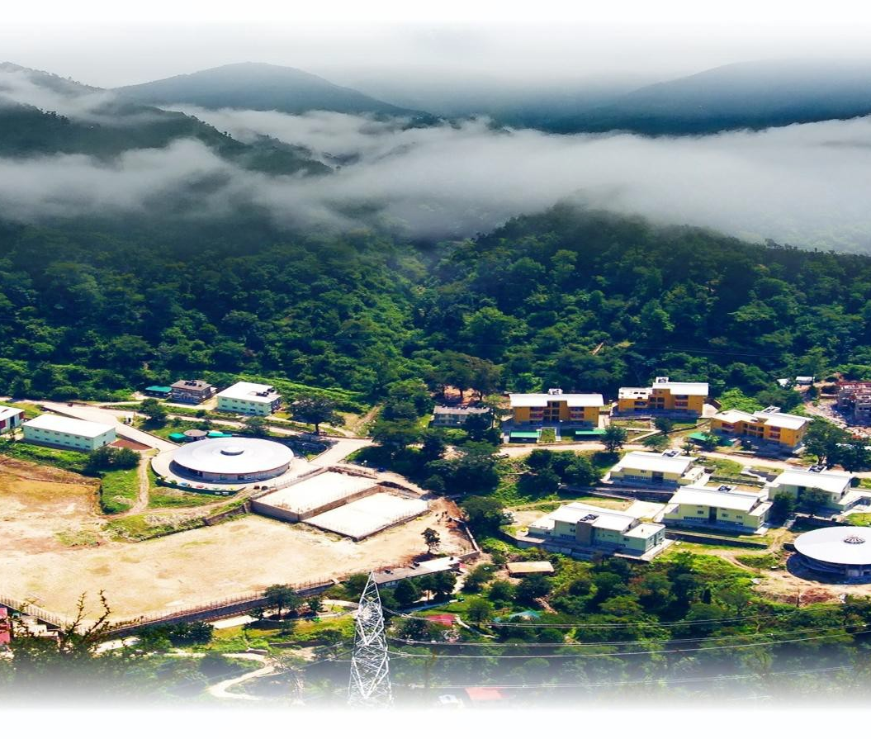
Thank you for your attention.

